Slide 1
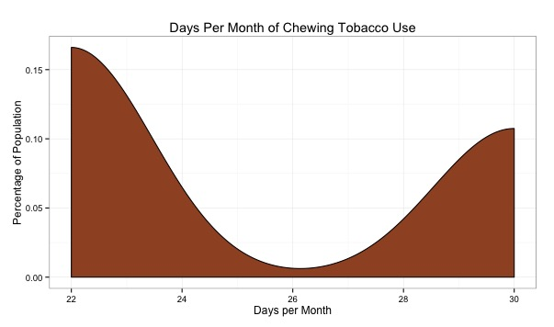
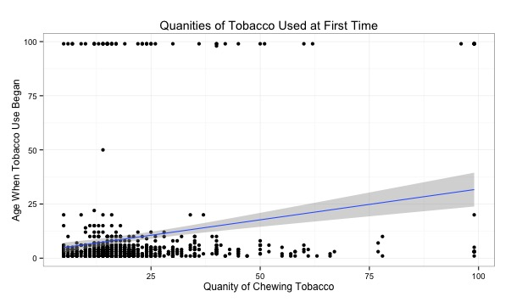
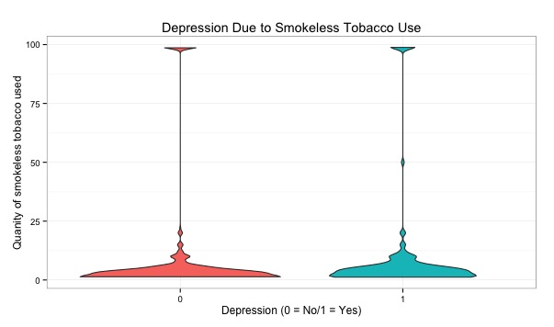

Determining if Smokeless Tobacco Causes Depression
By: Joe Sullivan
Results
Introduction
Pearson's Chi-squared test with Yates' continuity correction
While many people may know the risk factors of smokeless tobacco, snuff and chew, it seems that they choose to ignore it and take the risk. According to national health surveys, anywhere from 0.8% to 9.2% of US adults use smokeless tobacco regularly [3]. Alongside cancer, smokeless tobacco has been known to elevate the risk for depression, in a survey done by the National Institute on Drug Abuse [3].
data: Nicotine Dependence & Depression
X-squared = 1147.413, df = 1, p-value < 2.2e-16
Conclusion
The density plot shows that a great amount use smokeless tobacco almost everyday, each month.
While a majority don’t use a lot when they chew, as seen in the violin plot, just the use of that amount everyday can cause an addiction that is hard to get rid of.
Based off of the p-value from the Chi-squared test, we reject the null hypothesis and accept the alternative hypothesis. Therefore, there is a link between smokeless tobacco use and depression.
Research Question
Does the constant use of smokeless tobacco result in depression?
Sample
This sample is from the first wave of the National Epidemiological Survey on Alcohol and Related Conditions (NESARC) [3].
References
[1] Gupta and Johnson (2014)
Systematic Review and Meta-Analysis of Association of Smokeless Tobacco with Incidence of Oral Cancer
[2] Hema Sridhar, Thangarajan Rajkumar (2002)
The influence of smoking, drinking, paan-chewing and oral hygiene
[3] Fu, Qiang, Michael G. Vaughn (2014)
Psychiatric Correlates of Snuff and Chewing Tobacco Use
Methods
Correlation
Density Plot
Violin Plot
Chi Squared Test
Hypothesis
Ho: Tobacco dependence & depression are independent
Ha: Tobacco dependence & depression are not independent
Significance Level = .05
Faculty Advisor: Alan Arnholt

